Slide 1
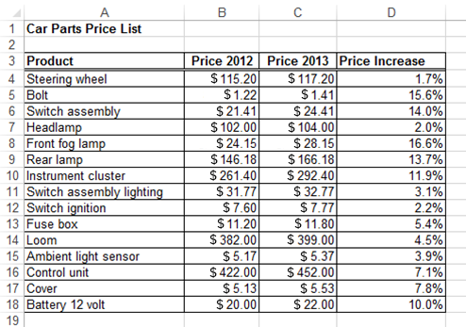
Formatting Numbers
In this presentation you will:
see how to change the appearance of numbers in a spreadsheet
Next >

Slide 2
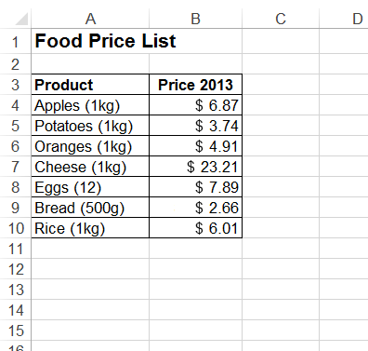
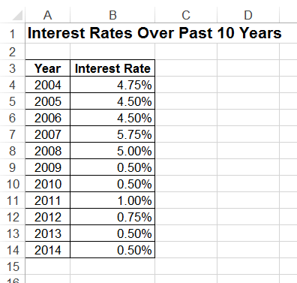
Introduction
A spreadsheet application has many tools for working with numbers.
Numbers can be formatted in many ways; these columns use currency and percentages.
Next >

Slide 3
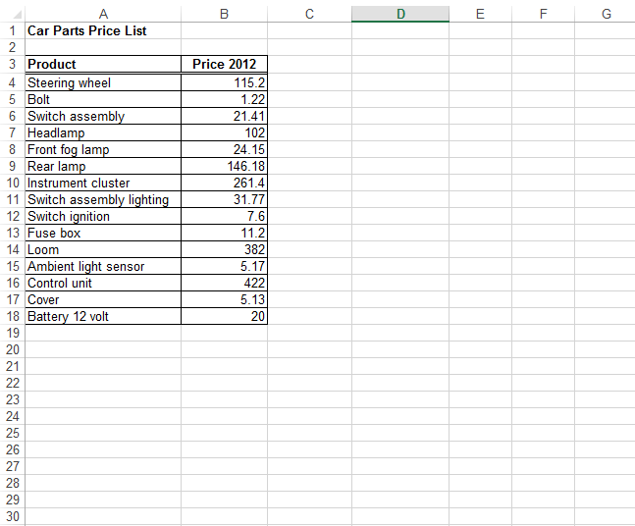
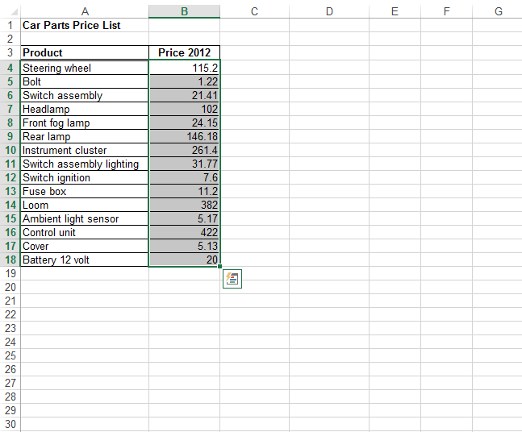
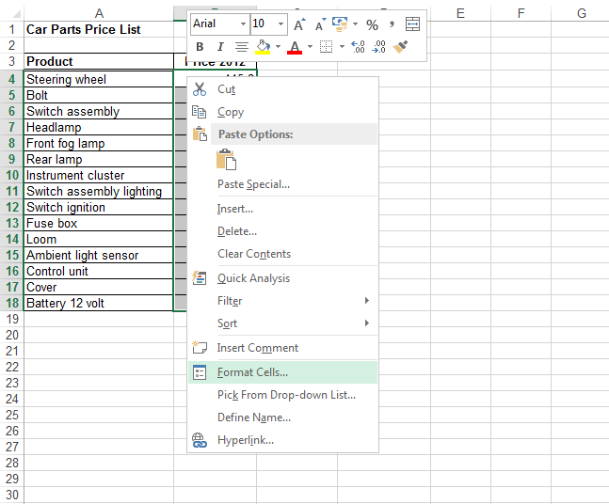
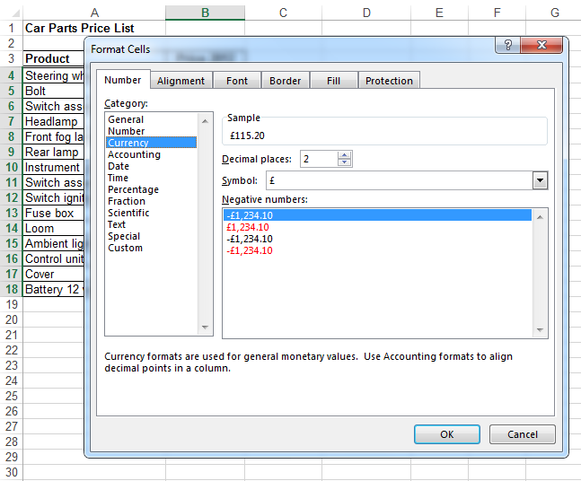
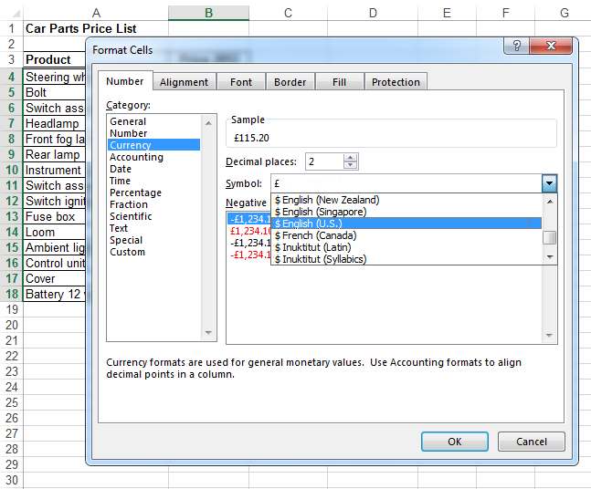
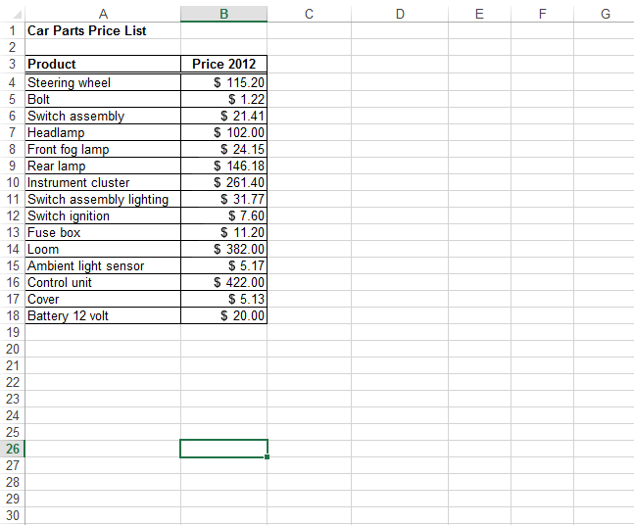

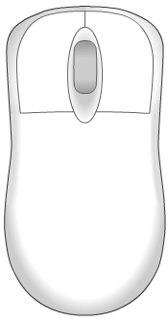


Formatting Numbers
Currency symbol added.
Value formatted to two decimal places.
To format a list of prices, select the cells.
Format the cells by selecting Currency from the menu.
Next >

Slide 4
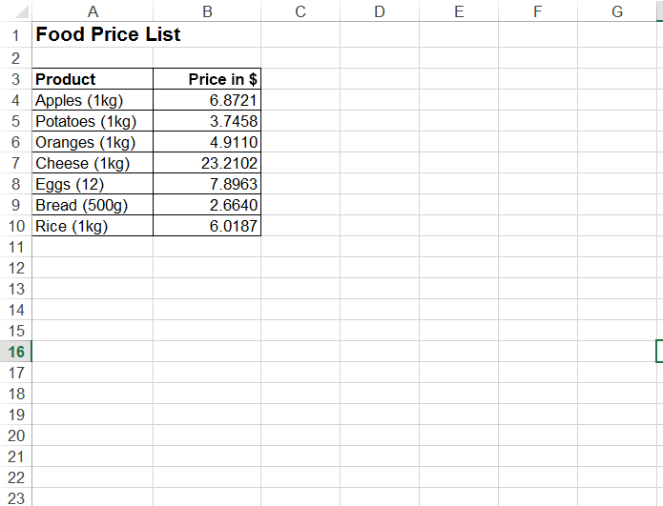
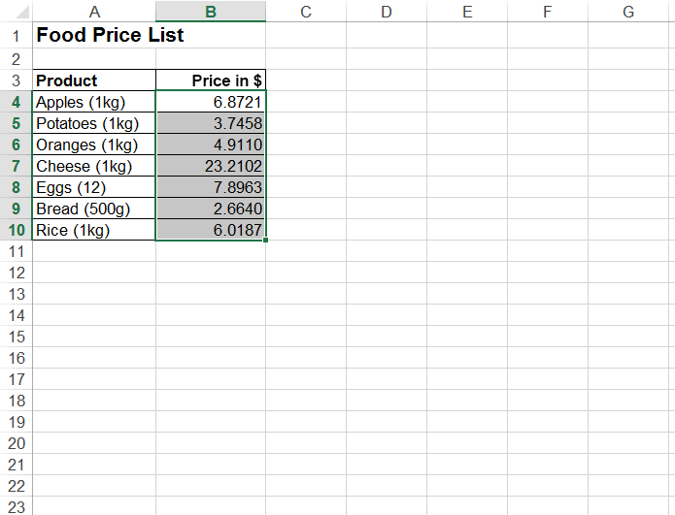
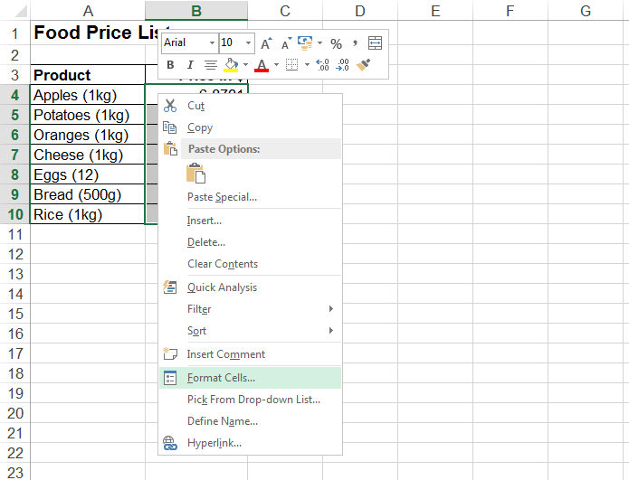
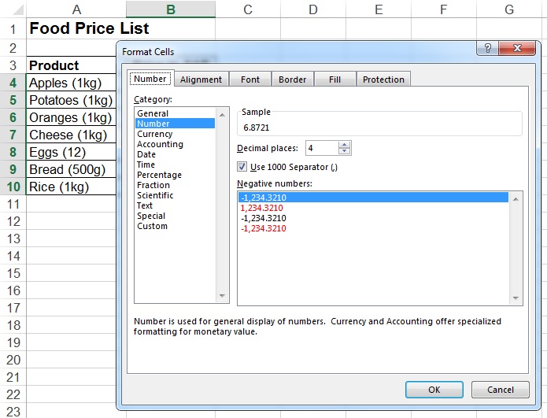

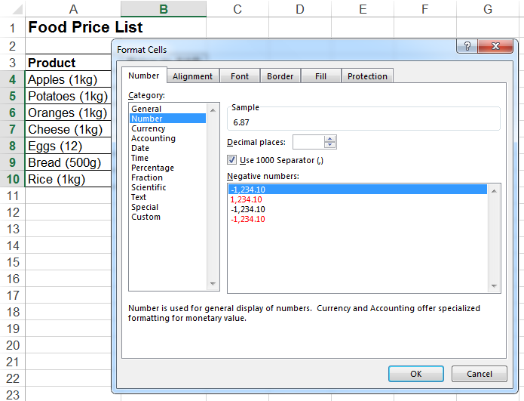
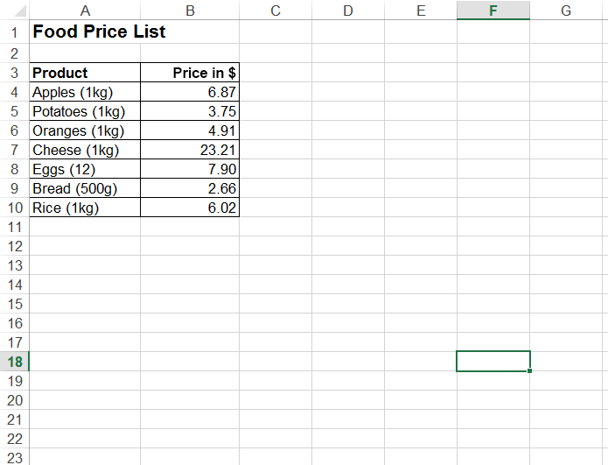
Decimal Places
2
The number of decimal places can be chosen.
For currency, the number of decimal places is usually two.
Next >

Slide 5
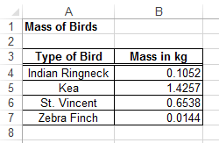
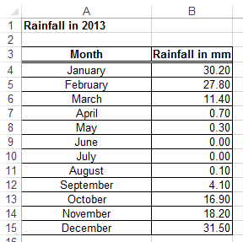
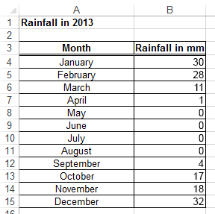
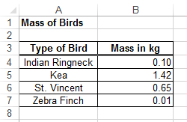
Decimal Places
From 2 d.p. to 0 d.p.
From 4 d.p. to 2 d.p.
With scientific data, numbers can be formatted to several different numbers of decimal places.
Next >

Slide 6
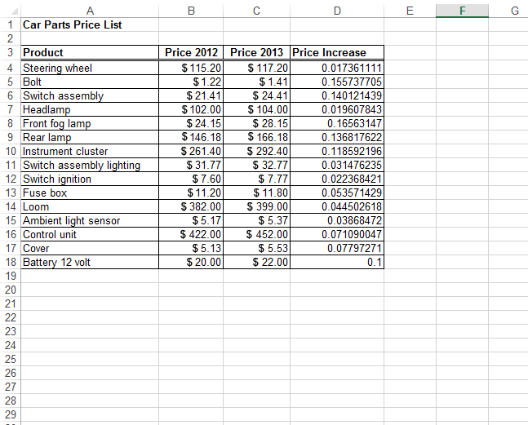
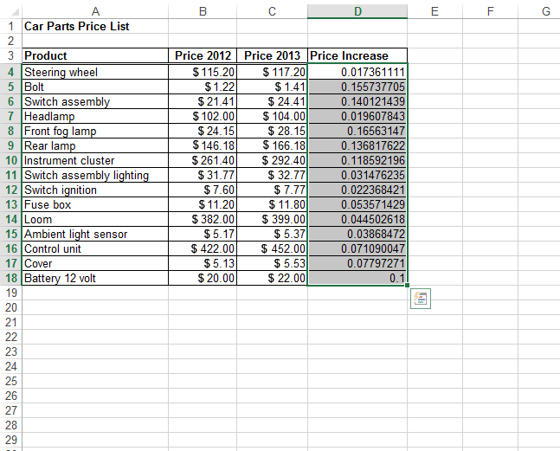
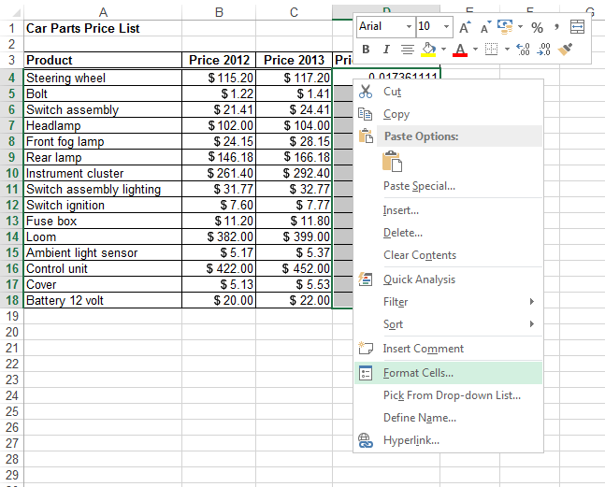
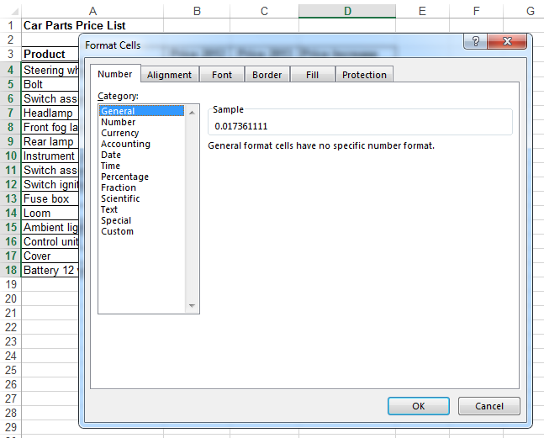
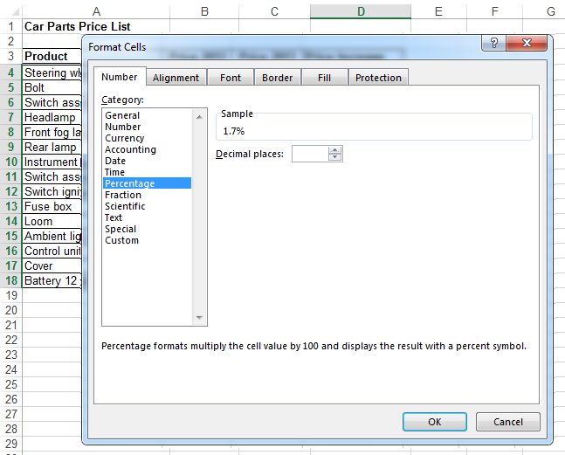
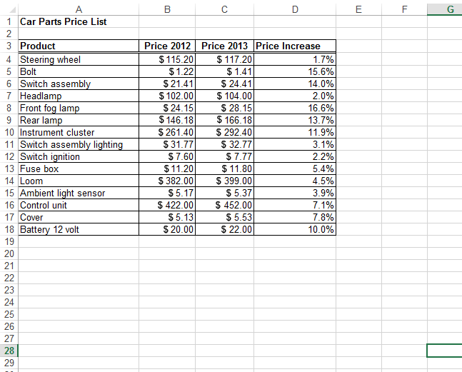
Percentages
1
Formatted as percentage.
Value formatted to one decimal place.
Decimal numbers can be formatted as percentages.
Select the cells and format them as a percentage with a number of decimal places.
Next >

Slide 7
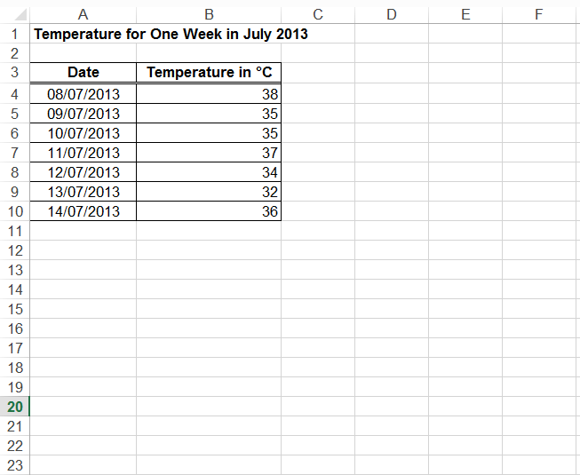
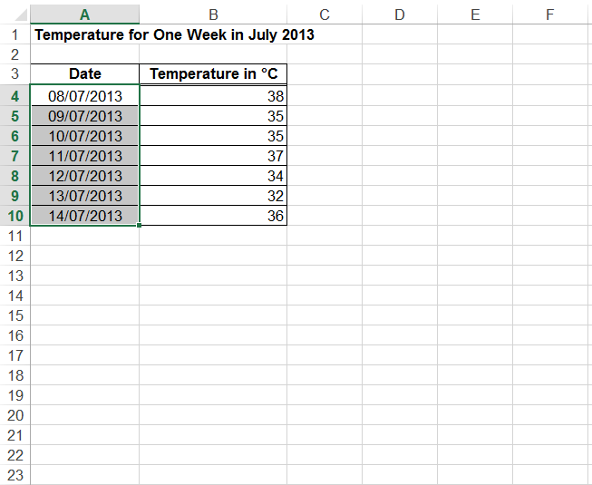
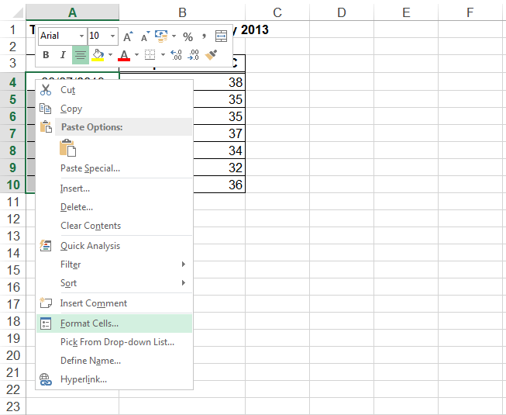
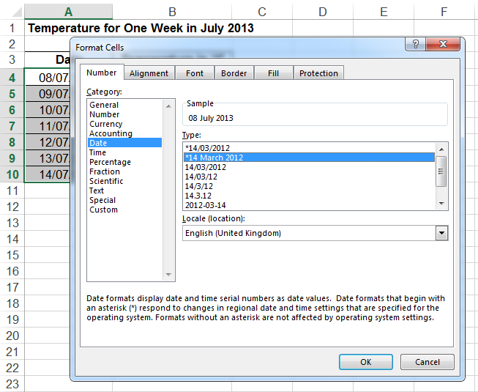
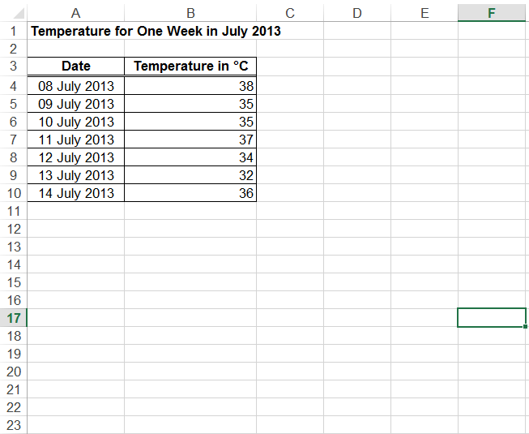
Formatting Dates
Spreadsheet applications also work with dates.
Dates can be formatted in different ways.
Next >

Slide 8
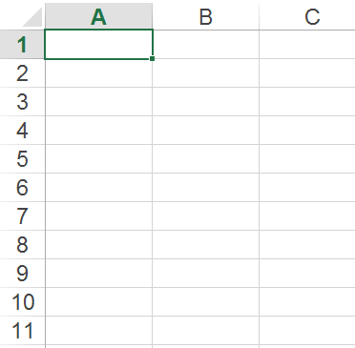
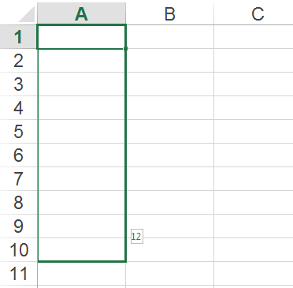
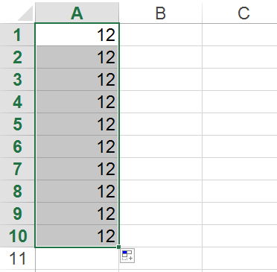
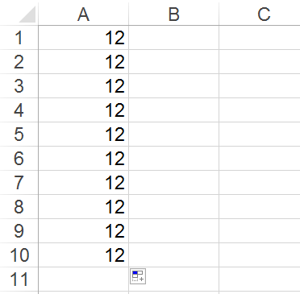

Entering Numbers
1
2
The Auto Fill tool enters a series of numbers quickly.
Enter the number in the first cell and then drag into the cells below to copy the number.
Next >

Slide 9
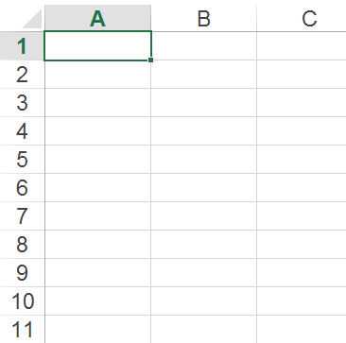
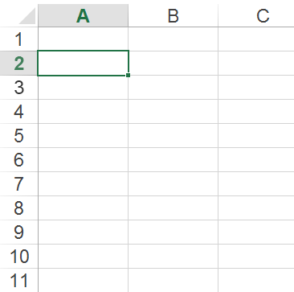
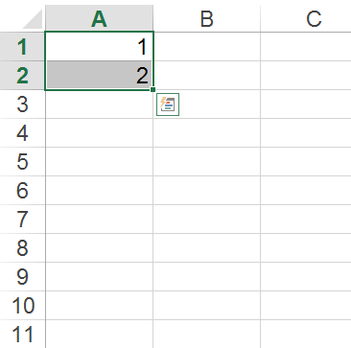
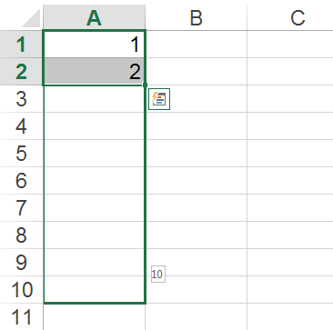
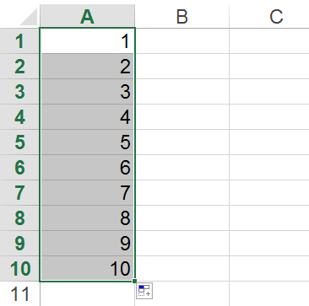
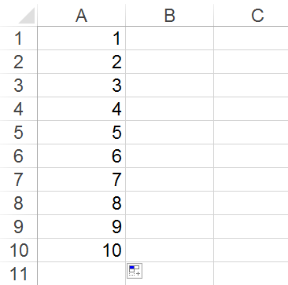
Entering Numbers
1
2
The Auto Fill tool can also enter a sequence of numbers.
Enter the first two numbers in sequence, select and then drag to fill the cells below.
Next >

Slide 10
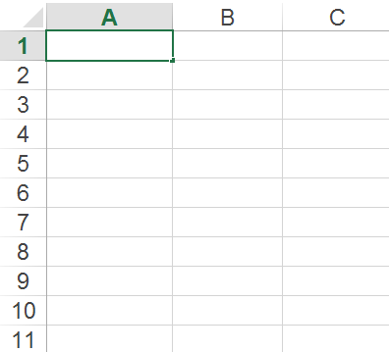
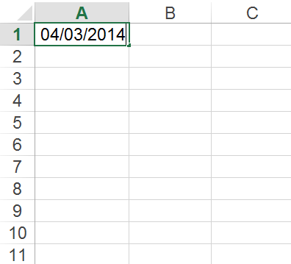
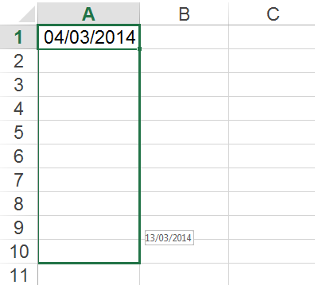
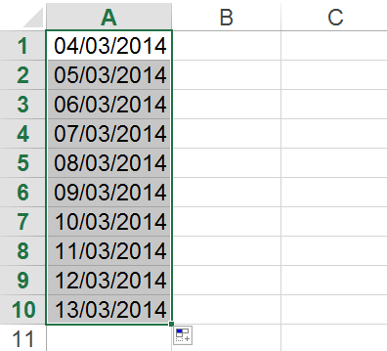
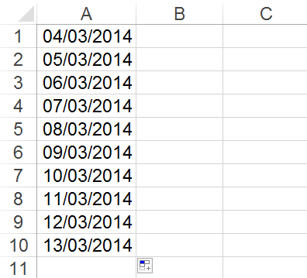
Entering other Data
The Auto Fill tool can also enter a sequence of dates.
Next >

Slide 11
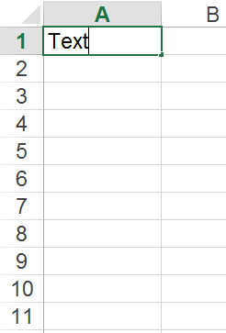
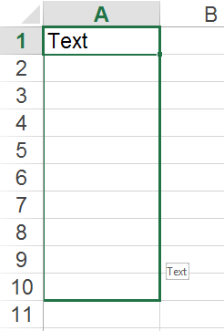
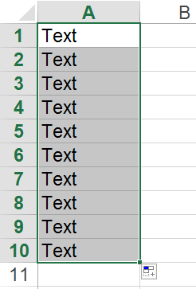
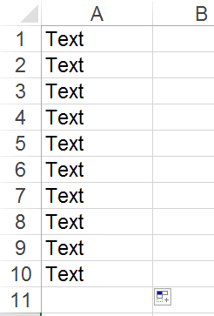





Entering other Data
The Auto Fill tool can also copy text and formulae into adjacent cells quickly.
Next >

Slide 12
Question 1
Which format would be used for a list of prices in a spreadsheet?
A) General
B) Number
C) Currency
D) Percentage
Next >

Slide 13

Question 1
Which format would be used for a list of prices in a spreadsheet?
A) General
B) Number
C) Currency
D) Percentage
The currency format is used for prices. It adds a currency symbol and is usually formatted to two decimal places.
Next >

Slide 14
Question 2
Which types of data can be entered or copied quickly using the Auto Fill tool?
A) A series of numbers (1,1,1,1,1…)
B) A sequence of numbers (1, 2, 3, 4, 5, 6…)
C) A sequence of dates (01/01/14, 02/01/14, 03/01/14 …
D) All of the above
Next >

Slide 15
Question 2
Which types of data can be entered or copied quickly using the Auto Fill tool?
A) A series of numbers (1,1,1,1,1…)
B) A sequence of numbers (1, 2, 3, 4, 5, 6…)
C) A sequence of dates (01/01/14, 02/01/14, 03/01/14 …
D) All of the above
The Auto Fill tool can be used to enter a series of numbers or a sequence of numbers or dates quickly. It can also be used to copy text and formula into adjacent cells quickly.
Next >

Slide 16
Summary
In this presentation you have seen:
how to format numbers as currency and percentages
how to format dates
how to use the Auto Fill tool to enter data into a spreadsheet
End

